Slide 1




Craft Beer and Brewery Case Study
DS 6306 – Project One
Jason Burk

Slide 2
Number of Breweries by State
CO | 265 | NY | 74 | IA | 30 | KS | 23 | NV | 11
CA | 183 | WA | 68 | ID | 30 | KY | 21 | AL | 10
MI | 162 | NC | 59 | CT | 27 | MD | 21 | NH | 8
IN | 139 | FL | 58 | HI | 27 | LA | 19 | NJ | 8
TX | 130 | MN | 55 | ME | 27 | OK | 19 | SD | 7
OR | 125 | OH | 49 | RI | 27 | GA | 16 | TN | 6
PA | 100 | AZ | 47 | VT | 27 | WY | 15 | AR | 5
IL | 91 | MO | 42 | UT | 26 | NM | 14 | ND | 3
WI | 87 | MT | 40 | AK | 25 | SC | 14 | DE | 2
MA | 82 | VA | 40 | NE | 25 | MS | 11 | WV | 2
 |  |  |  |  |  |  |  | DC | 8

Slide 3
Data Files Contained Missing Data
Using a function called “MICE” or Multivariate Imputation by Chained Equations we were able to infer values for Alcohol by Volume (ABV) and International Bitterness Units (IBU) where missing.
The MICE algorithm imputes an incomplete column (the target column) by generating 'plausible' synthetic values given other columns in the data.

Slide 4
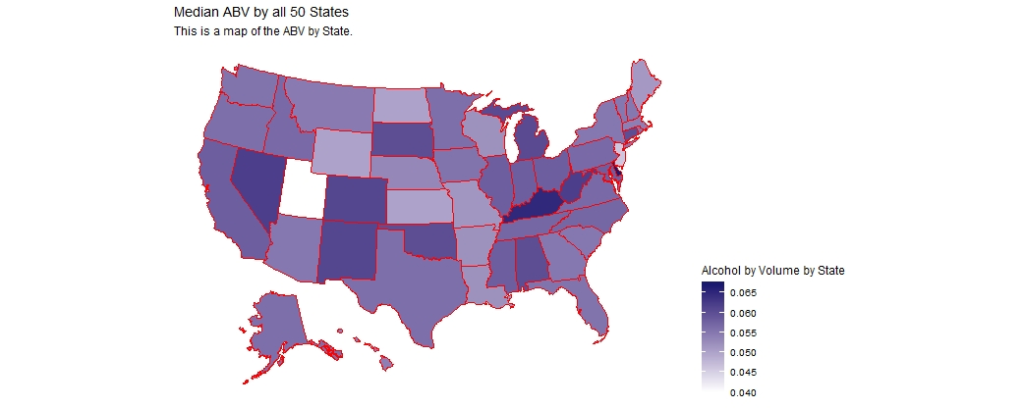
Median Alcohol Content (ABV) by State
Bud ABV: 5%

Slide 5
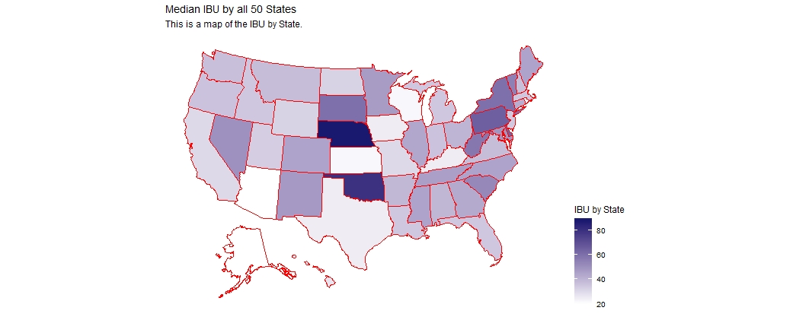
Median International Bitterness Units (IBU) by State
Bud IBU: 7

Slide 6
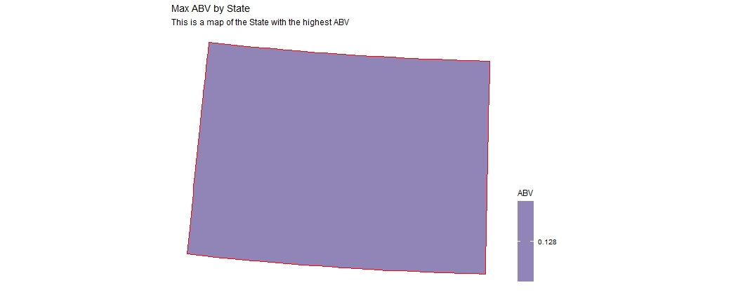

Maximum ABV and IBU by State COLORADO
ABV Max
ABV Max
0.128
138

Slide 7
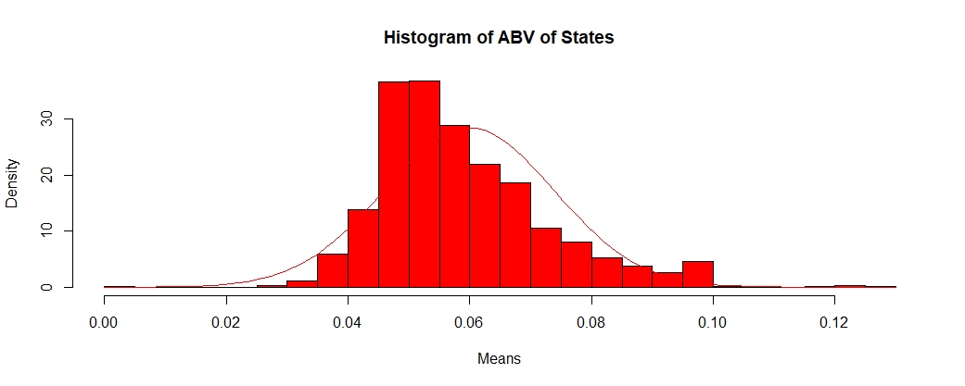
Histogram of ABVs

Slide 8
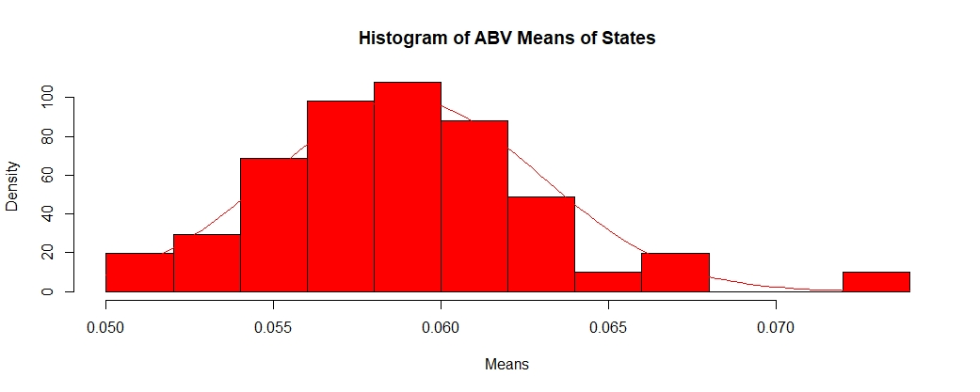
Histogram of ABV Means

Slide 9
ABV Summary Statistics
Min: 0.001
1st Qtr: 0.05
Median: 0.056
Mean: 0.0599
3rd Qtr: 0.068
Max: 0.128

Slide 10
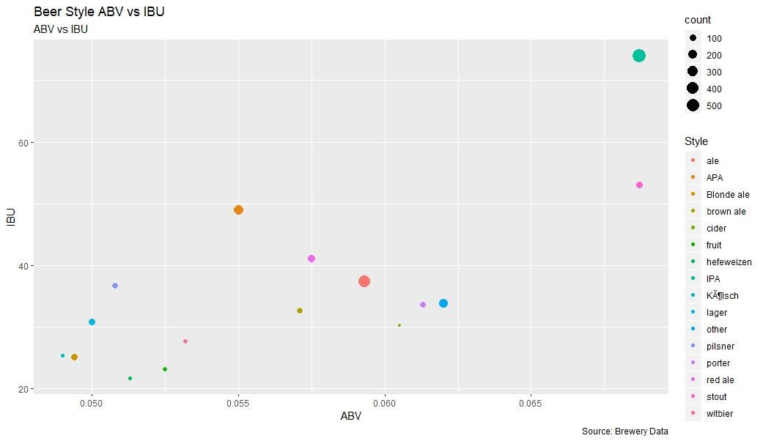
Alcohol by Volume and International Bitterness Units by Style
Notes:
#7

Slide 11
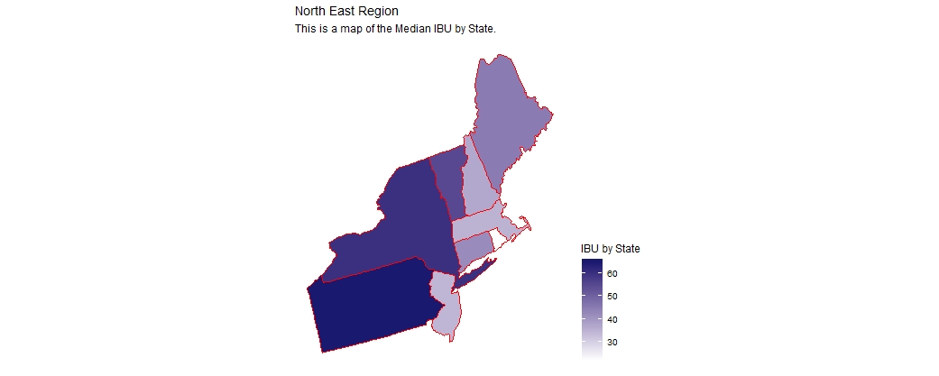
IBU by Region

Slide 12
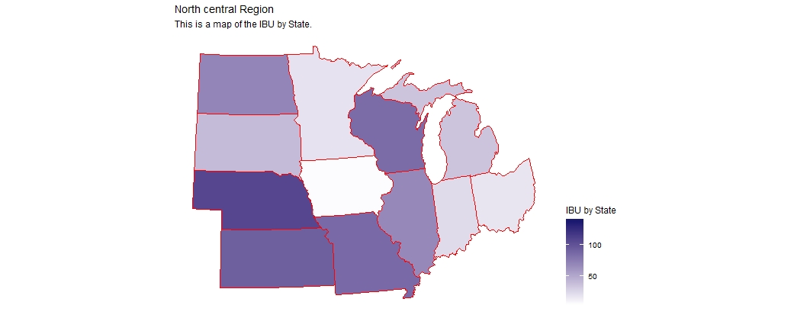
IBU by Region

Slide 13
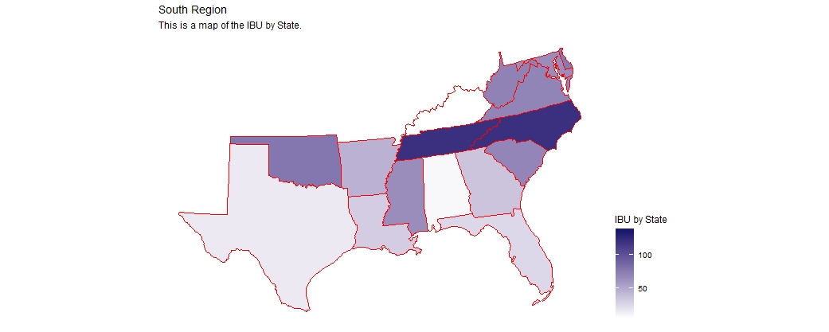
IBU by Region

Slide 14
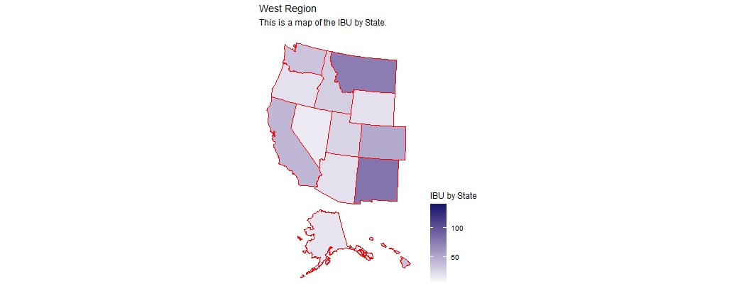
IBU by Region

Slide 15
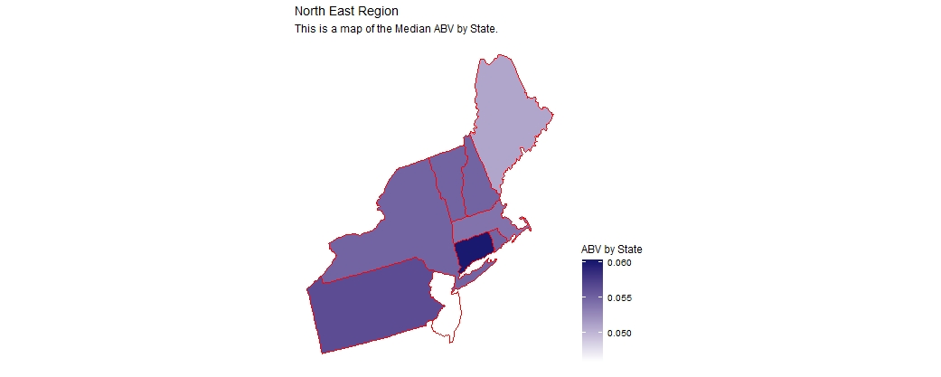
ABV by Region

Slide 16
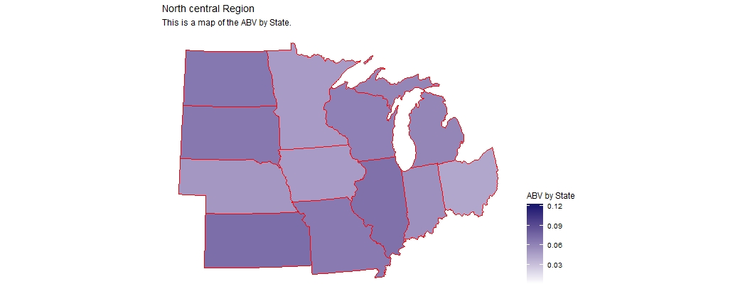
ABV by Region

Slide 17
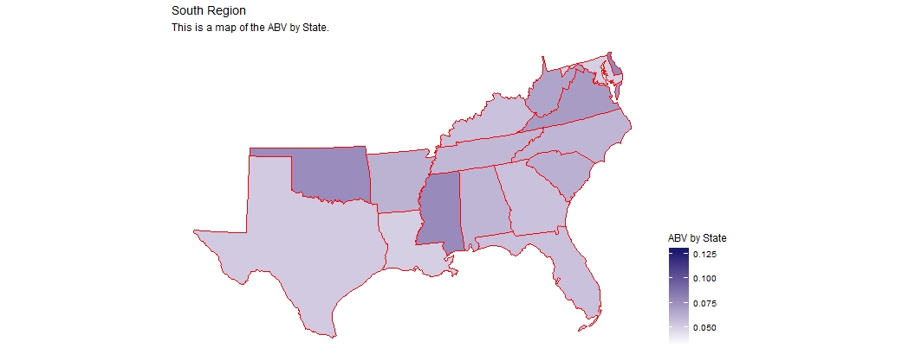
ABV by Region

Slide 18
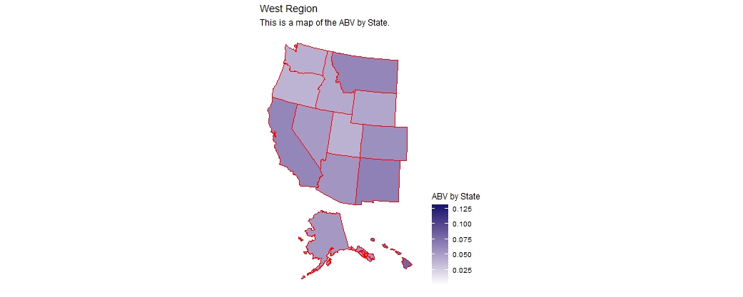
ABV by Region

Slide 19
Thank you
Notes:
Thank you

